Slide 1
Predicate Logic

Slide 2
What is predicate logic?
Consider the following sentence:
Every person who is 18 years or older, is eligible to vote
Can express the sentence using propositional logic only?
The answer is: No
In the example sentence, there are two variables: person and age
The person is depended on age
‘Eligible to vote?’ – can be answered using true or false.
That means this part is a simple logic
However, ‘Every person who is 18 years or older’ depends specific condition.
We cannot express it using simple logic
That means we need a more powerful logic to express it.
And that is predicate logic.

Slide 3
What is predicate logic?
Predicate logic is an extension of propositional logic.
It combines the concept of predicate and quantifiers to better capture the meaning of statements that cannot be meaningfully expressed by propositional logic only.

Slide 4
What is predicate?
Consider the statement: ‘5 is greater 3’
Is it a statement?
Yes: ‘5 is greater 3’
Consider another statement: ‘X is greater than 3’
Is it a statement?
The answer is not straightforward.
Consider the following scenario:
Value of X | Value of the Statement
X = 1 | False
X = 3 | False
X = 5 | True
A proposition can have either true or false value. And they cannot interchange

Slide 5
What is predicate?
The sentence: ‘X is greater than 3’
Let’s dissolve the sentence into two parts: Subject and predicate
Subject: x
Predicate: ‘is greater than 3’
That means, predicate is the part of the sentence that does not change.
The value of the predicate depends on subject
Here, the value (true or false) of ‘is greater than 3’ depends on x
Therefore, the sentence is a function of x

Slide 6
What is predicate?
We can express the sentence ‘X is greater than 3’ using a mathematical function P(x)
Here, P is the predicate and x is the subject (or variable)
Now P(x) can be either true or false depending on the value of x.
Once the value of x is assigned, then P(x) can be either true or false but not both at the same time.
And for that particular x, it never changes.
That means P(x) becomes a proposition.

Slide 7
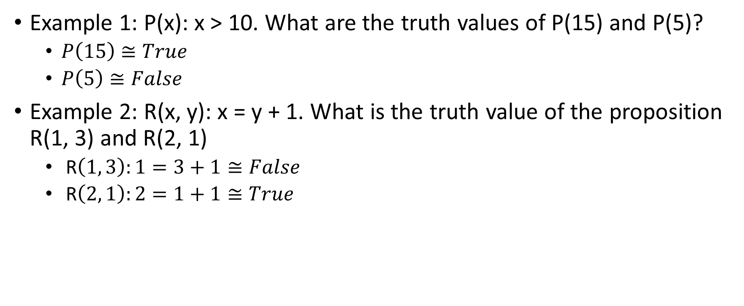
Example of Predicate Logic
Example 1: P(x): x > 10. What are the truth values of P(15) and P(5)?
$P\left(15\right)≅True$
$P\left(5\right)≅False$
Example 2: R(x, y): x = y + 1. What is the truth value of the proposition R(1, 3) and R(2, 1)
R$\left(1, 3\right):1=3+1≅False$
R$\left(2, 1\right):2=1+1≅True$

